Slide 1
Case Project 1
Observations on Banking Dataset
Dushyant Pratap Singh
dushyant.singh@iitg.ac.in

Slide 2
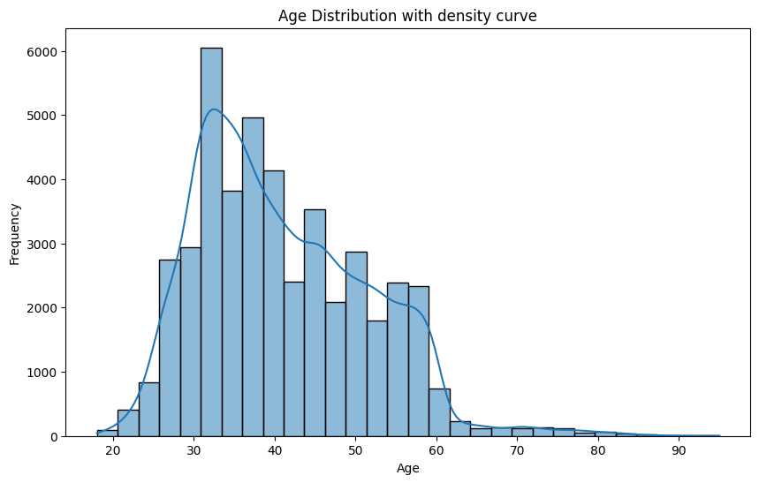
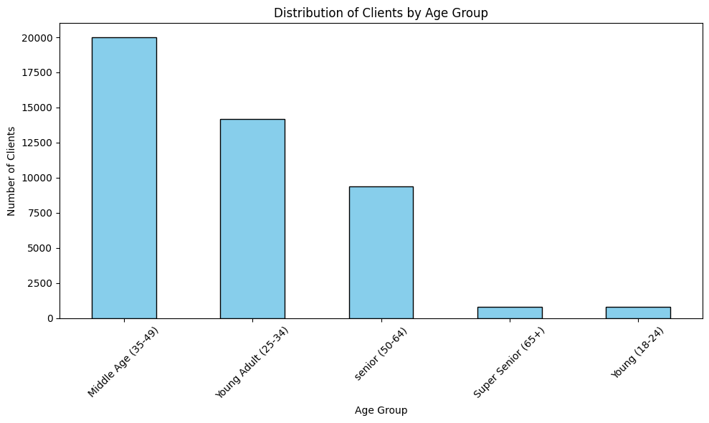
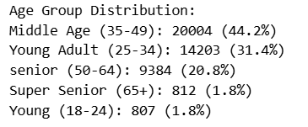
Distribution of Age among the Clients
Middle-aged individuals (35-49) make up the largest portion of the population, accounting for 44.2%. This indicates that nearly half of the group falls within this age range, which may have significant implications for services, marketing, or policy decisions targeting this demographic.

Slide 3
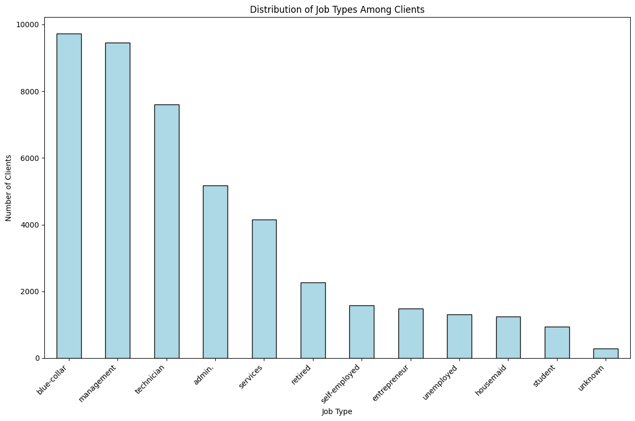
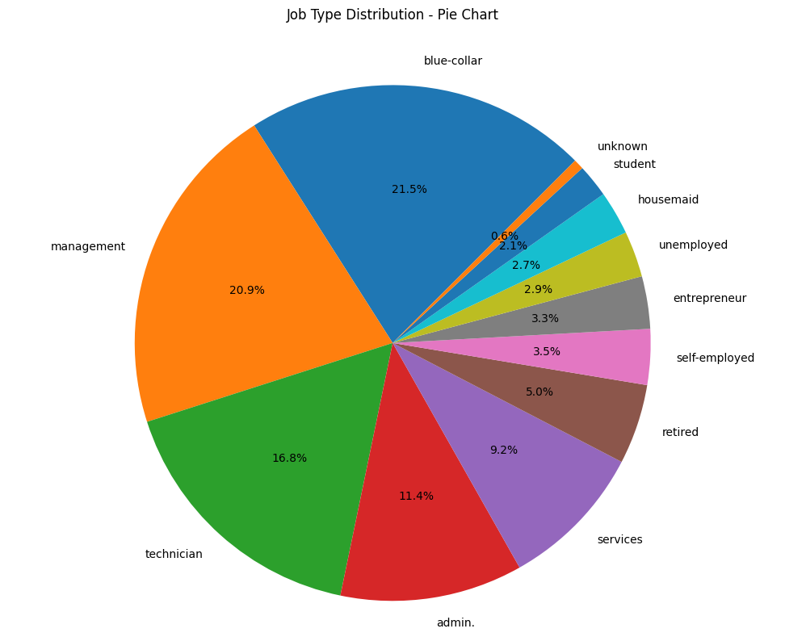
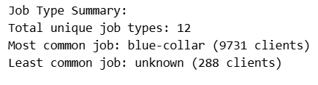
Distribution of Job type among the Clients
Blue-collar jobs are the most common among clients, with 9,731 individuals, making this group the largest represented job type in the dataset.

Slide 4
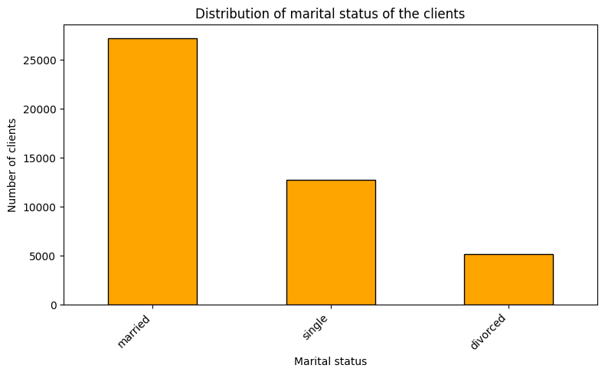
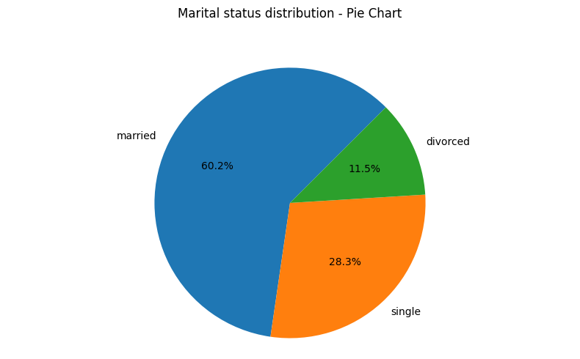

Marital status distribution of Clients
Married individuals make up the largest group in the dataset, with 27,216 people. This suggests that the majority of the population represented in the data are married, compared to 12,787 single and 5,207 divorced individuals.

Slide 5
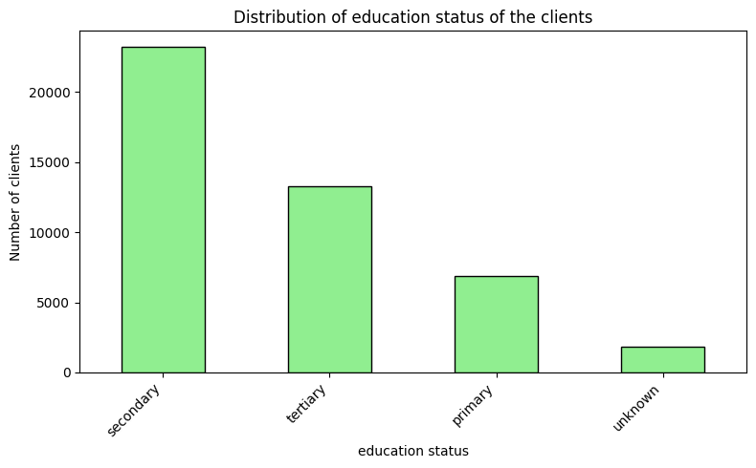
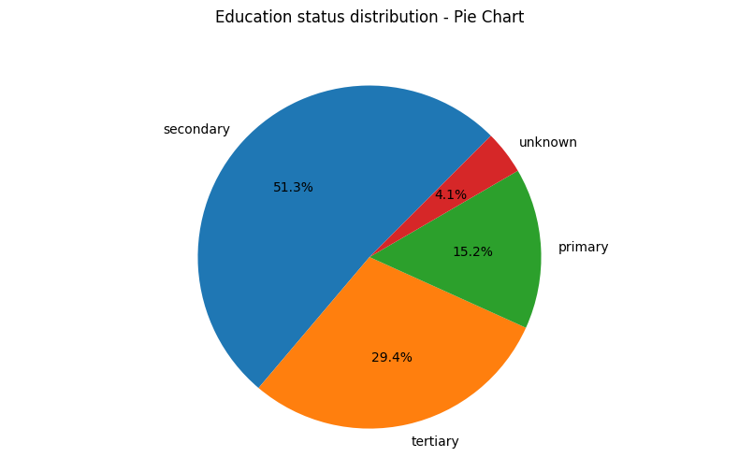

Level of Education among the Clients
Secondary education is the most common education level, with 23,201 individuals. This group is followed by those with tertiary education (13,301), primary education (6,851), and a smaller group with unknown education status (1,857). This suggests that the majority of individuals in the dataset have completed secondary education, indicating its prevalence as the primary educational attainment

Slide 6
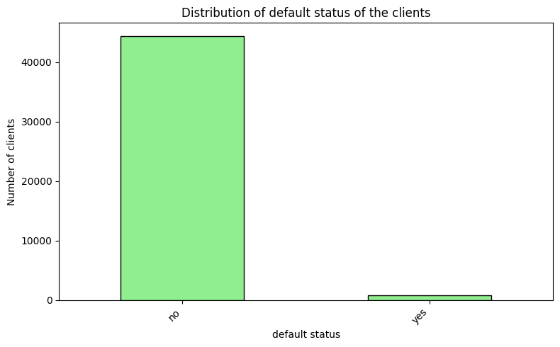
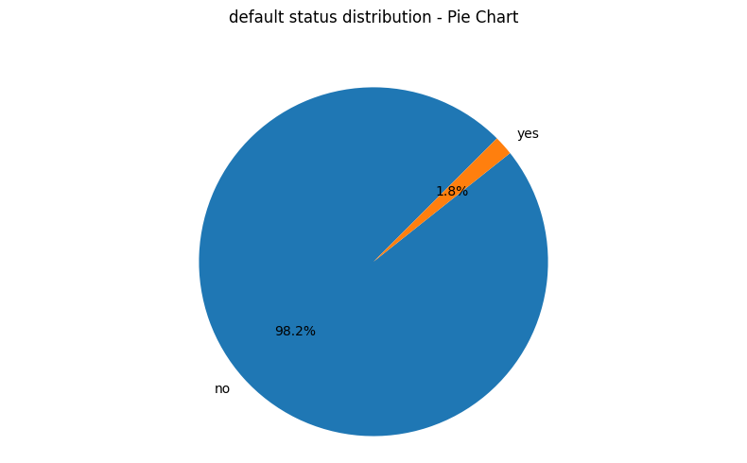
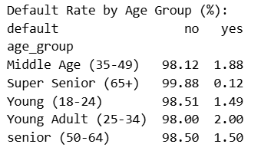
Proportion of clients have credit card in default
Super seniors (65+) have the lowest default rate.
The default rate for the Super Senior group is exceptionally low at just 0.12%. This suggests that individuals aged 65 and above are the least likely to default on their loans compared to other age groups.
Young adults (25-34) have the highest default rate
The Young Adult group shows the highest default rate at 2.00%. This indicates that individuals in this age range are at greater risk of defaulting, possibly due to less financial stability or experience.

Slide 7
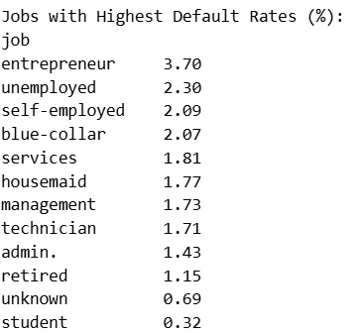
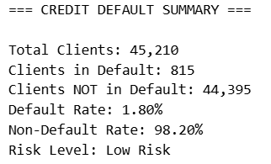
Entrepreneurs face the highest default rate.
The default rate for entrepreneurs is the highest among all listed jobs, at 3.70%. This suggests that entrepreneurial ventures may carry significant financial risk, possibly due to income instability or business uncertainties.
Unemployment and self-employment are high-risk categories.
Both unemployed individuals (2.30%) and self-employed workers (2.09%) have notably higher default rates compared to most other job categories. This indicates that lack of stable employment or variable income sources increases the likelihood of default.
Students and retired individuals have the lowest default rates.
Students (0.32%) and retired individuals (1.15%) show the lowest default rates among the groups listed. This may reflect lower exposure to high-risk credit or more conservative financial behaviors within these demographics.
Very low default rates.
Only 1.80% of clients are in default, indicating that the vast majority of clients are meeting their credit obligations. This suggests strong overall credit quality among the client base.
Low Overall risk level.
With a non-default rate of 98.20% and the risk level classified as "Low Risk," the portfolio is considered financially stable and unlikely to experience significant credit losses.

Slide 8
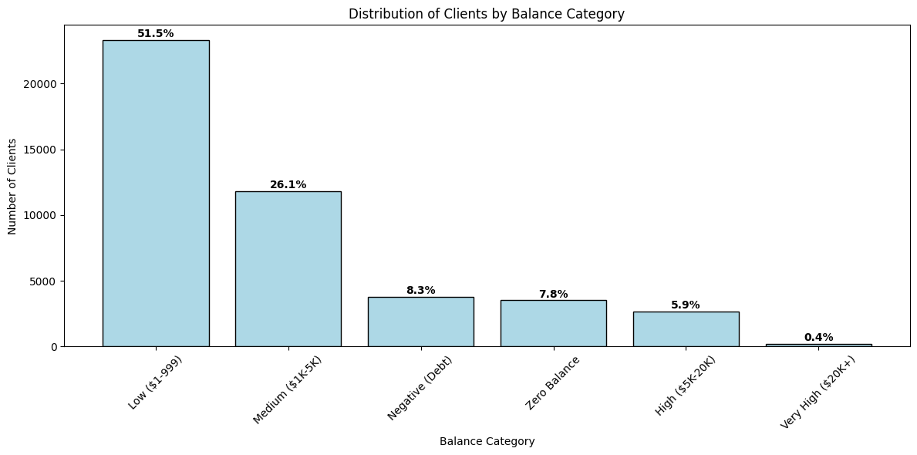
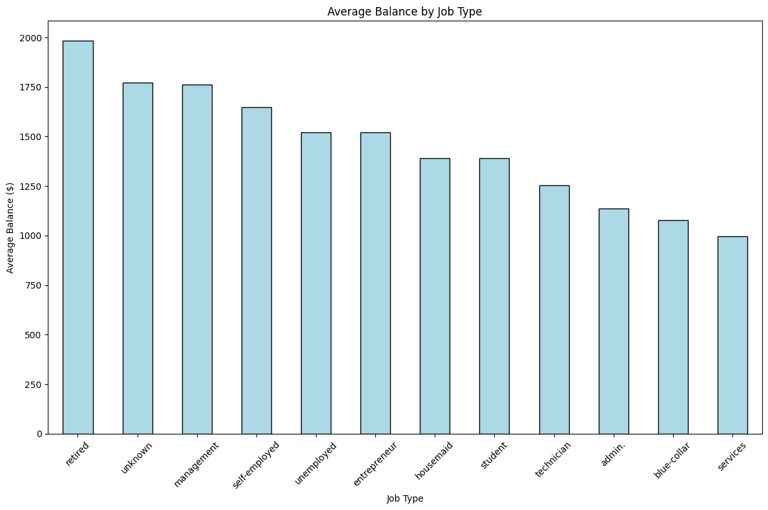
Average yearly balance distribution
Most clients have low balance.
Over half (51.5%) of clients fall into the "Low" balance category ($1–$999), and only a very small fraction (0.4%) have "Very High" balances ($20,000+). This highlights a strong skew toward lower balances among clients.
Retired clients holds the highest average balances.
Among all job types, retired individuals have the highest average balance, approaching $2,000. In contrast, service workers and blue-collar workers have the lowest average balances, both under $1,200.

Slide 9
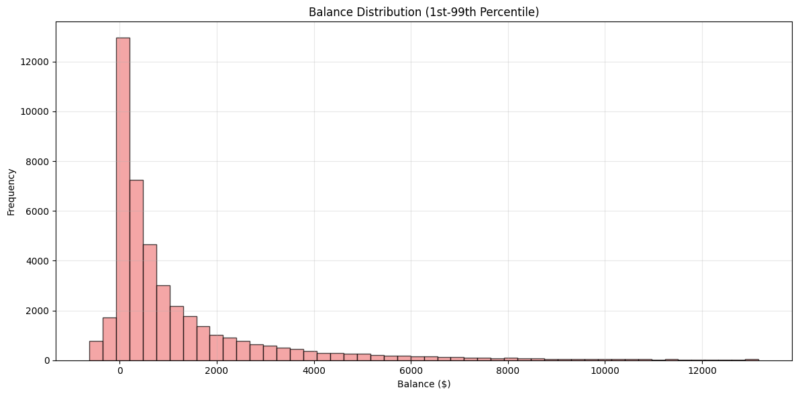
Balance distribution is heavily skewed.
The majority of client balances are clustered around low values, with a long tail extending toward higher balances. Most clients have balances below $2,000, as shown by the sharp drop-off in frequency as balance increases
Notable proportion with negative or zero balances.
A significant portion of clients have either negative balances (8.3%) or zero balances (7.8%), indicating that a non-trivial share of the population is either in debt or has no funds in their accounts.

Slide 10
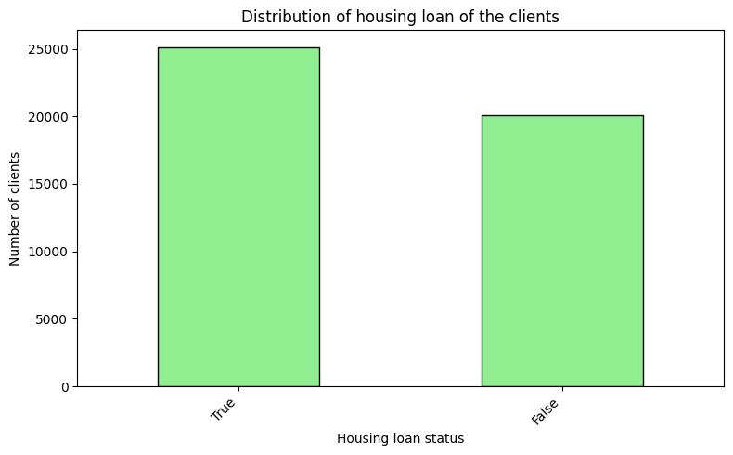
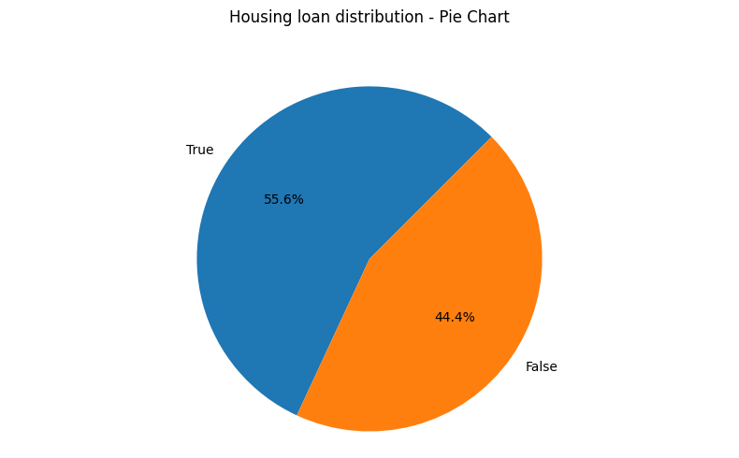
Clients having housing loan
Most clients have housing loans.
A majority of clients (about 55.6%) have an active housing loan, highlighting that home financing is common among the client base
Substantial minority without housing loans.
A significant portion (44.4%) of clients do not have a housing loan, indicating that a large group either owns homes outright, rents, or has not opted for housing credit.

Slide 11
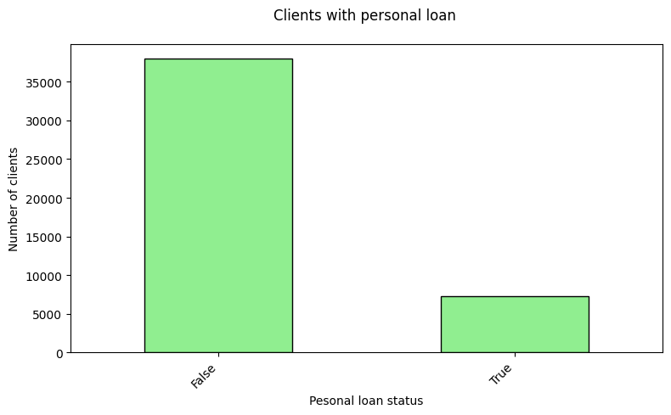
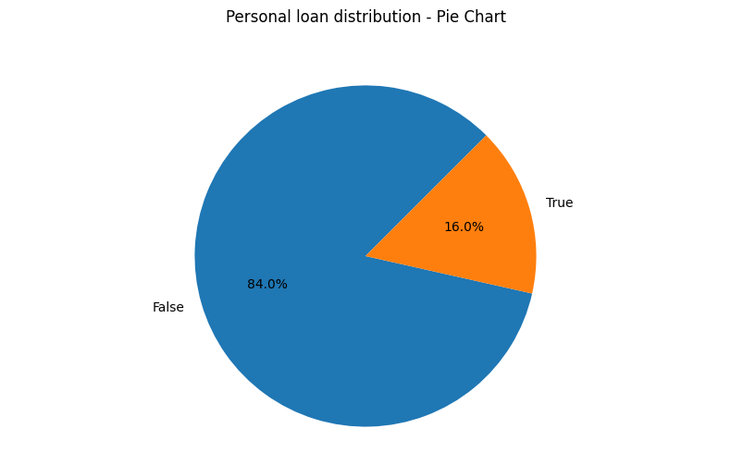
Clients having personal loan
Most clients do not have a personal loan.
A significant majority—84% of clients—do not have a personal loan. This indicates that personal loan uptake is relatively low among the client base
Personal loan holders are a small minority
Only 16% of clients have a personal loan, highlighting that borrowing for personal purposes is not widespread in this population.

Slide 12
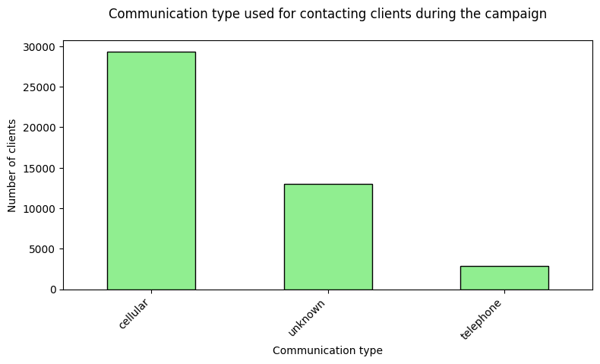
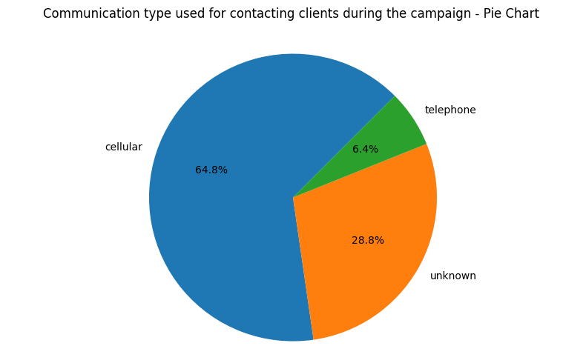
Communication types used for contacting Clients during the campaign
Cellular is the dominant communication channel.
The majority of clients were contacted via cellular phones, accounting for nearly two-thirds (64.8%) of all communications. This highlights the widespread use and preference for mobile communication during the campaign.
Traditional Telephone use is minimal.
Only a small fraction of clients (6.4%) were contacted using traditional telephones, indicating a significant decline in landlines compared to cellular and other methods.

Slide 13
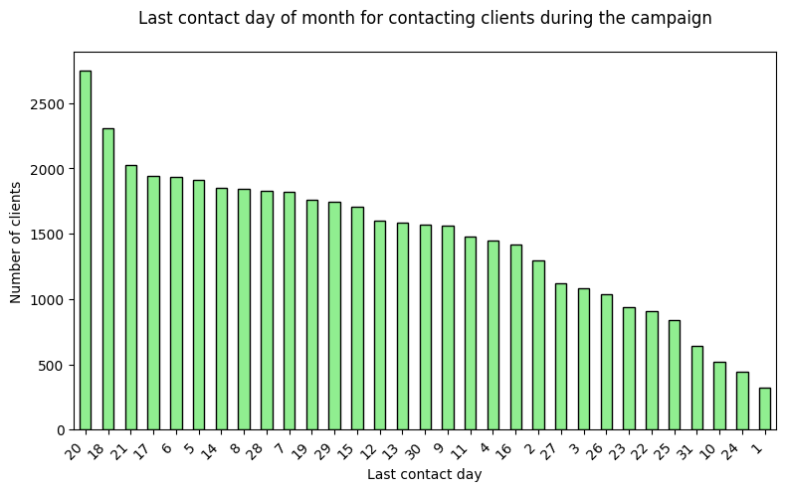
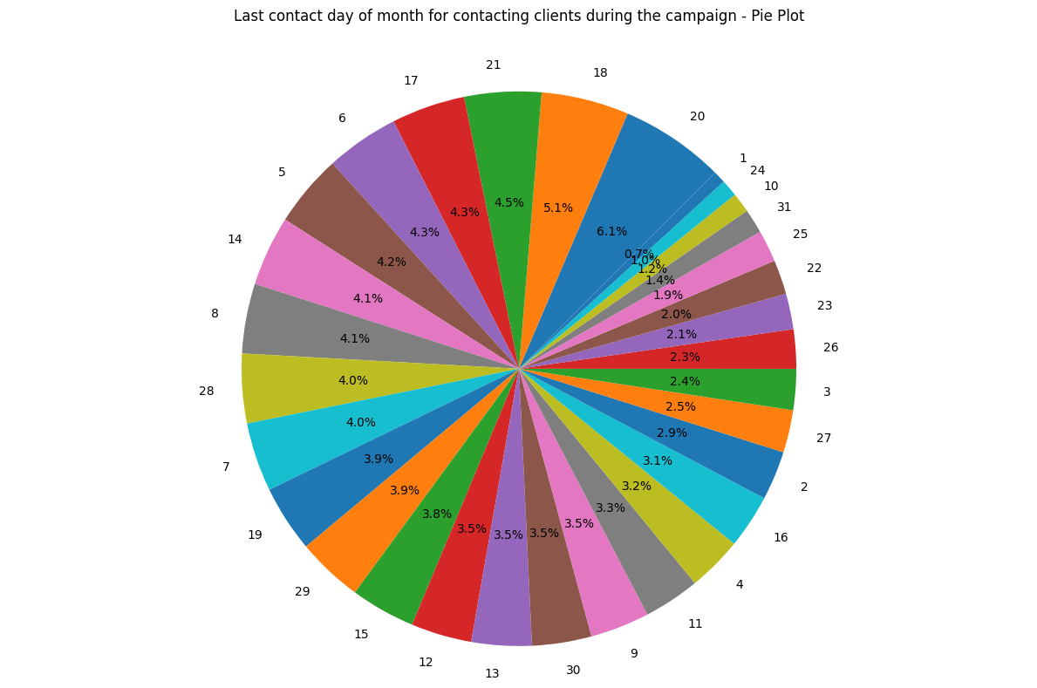
Distribution of last contact day of the month
Most Client contacts occurred around the 18th to 21st of the month.
The highest number of clients were last contacted on the 20th, 18th, and 21st days of the month. This suggests that campaign efforts were most intensive or effective during this period, as reflected by the peak in both the bar and pie charts.
Contact Frequency declines sharply toward the start and end of the month.
There is a noticeable drop in the number of clients contacted on the earliest (1st–5th) and latest (28th–31st) days of the month. This indicates that client outreach was less frequent at the very beginning and end of the month, possibly due to campaign scheduling or operational constraints.

Slide 14
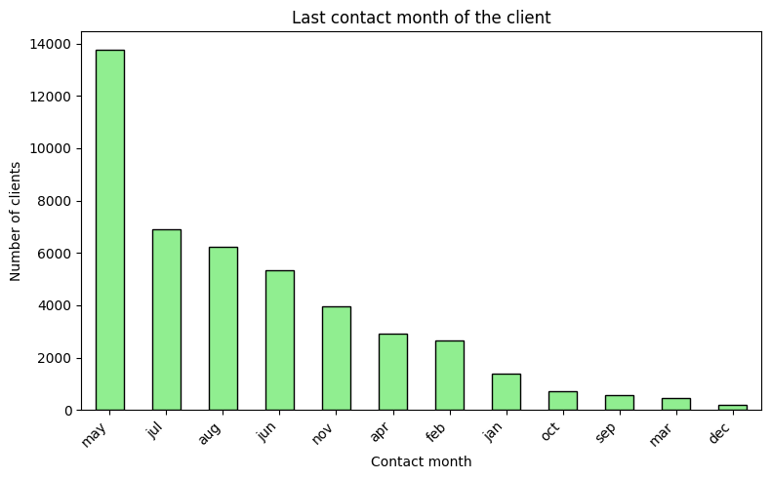
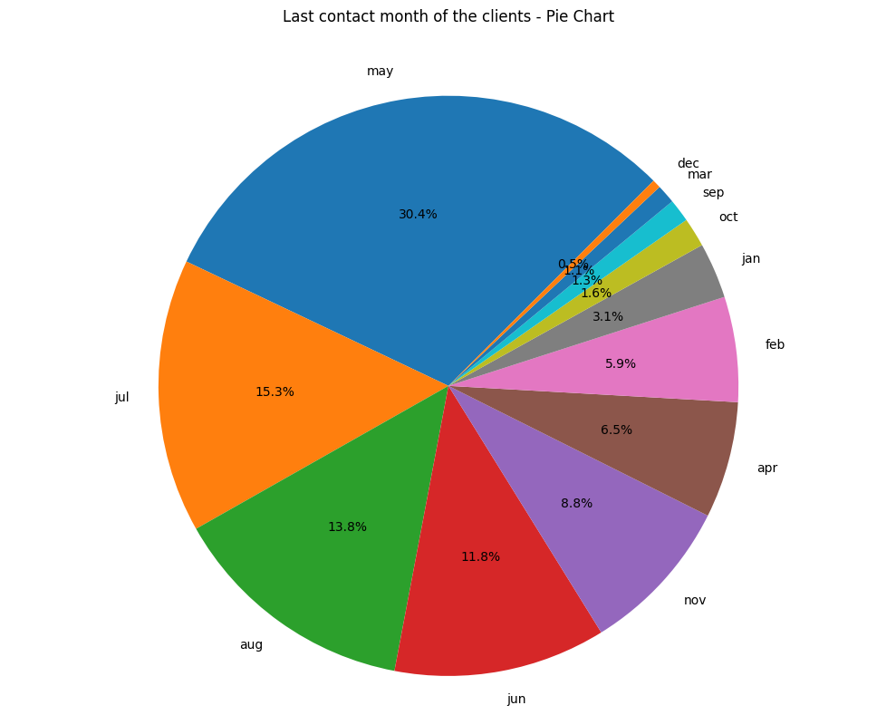
Last contact month among the clients
May is the most common month for Client contact.
The highest number of clients were last contacted in May, accounting for over 30% of all contacts. This is significantly higher than any other month, as shown by both the bar and pie charts.
Client contacts drop sharply after May.
There is a steep decline in the number of clients contacted after May, with July and August being the next most common months but at less than half the frequency of May. The remaining months have progressively fewer contacts, with December being the lowest.

Slide 15
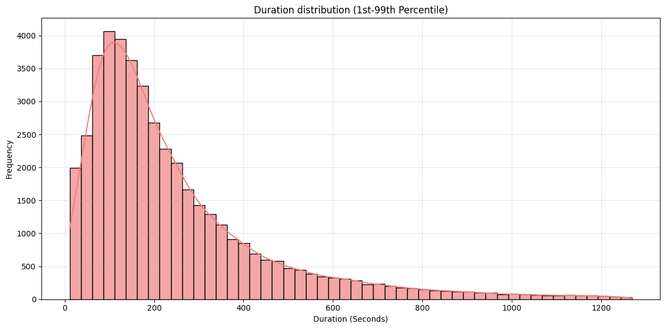
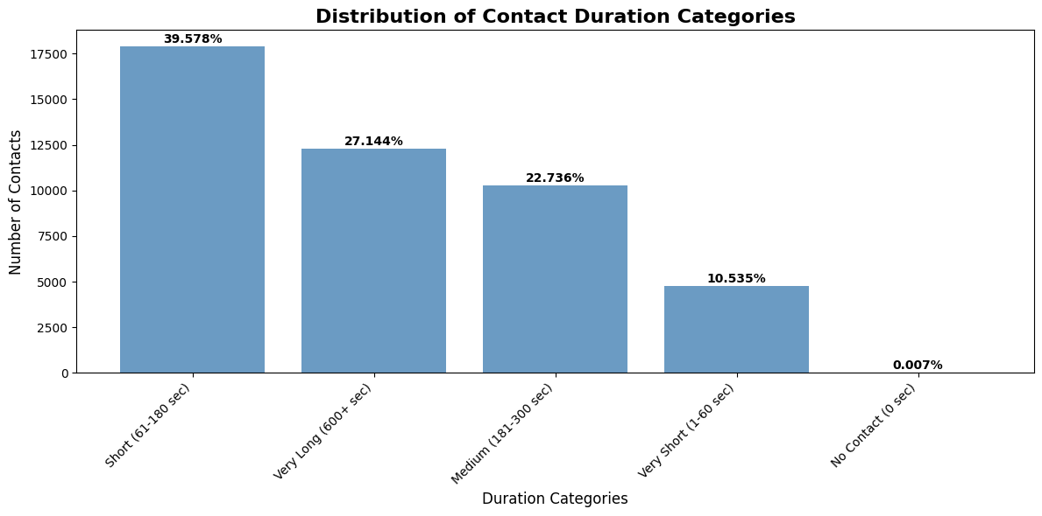
Duration of last contact
Most contacts are short in duration.
The majority of contacts fall into the "Short (61–180 sec)" category, making up nearly 40% of all contacts. This indicates that brief interactions are the most common.
Duration distribution is right-skewed.
The histogram shows a right-skewed distribution, with most contact durations clustered between 60 and 300 seconds. Very long durations (over 600 seconds) are relatively rare, but there is a long tail of longer contacts.

Slide 16
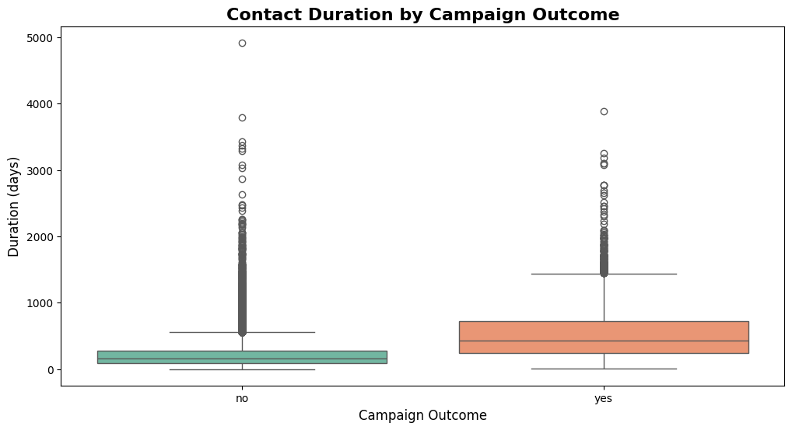
Longer Contacts are associated with successful campaign outcomes.
The boxplot comparing campaign outcomes reveals that successful outcomes ("yes") tend to have longer contact durations on average compared to unsuccessful ones ("no"). This suggests that extended conversations may contribute to better campaign results.
Very short or No contact is uncommon.
Only a small fraction of contacts are classified as "Very Short (1–60 sec)" or "No Contact (0 sec)," together accounting for just over 10% of all cases. This highlights that most client interactions are substantive rather than fleeting.

Slide 17
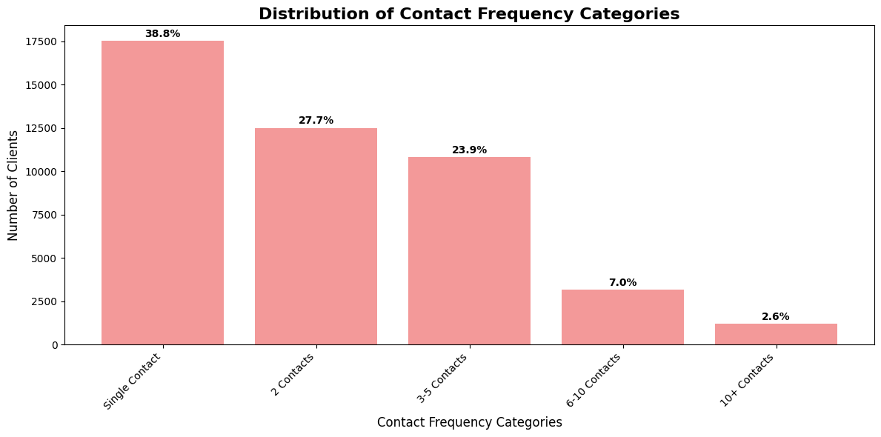
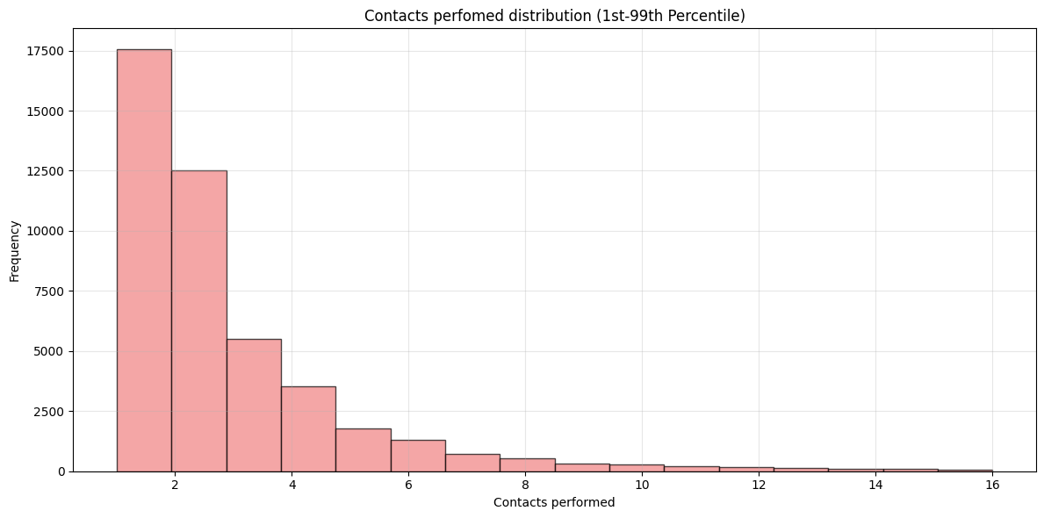
Number of contacts performed during the campaign
Most Clients are contacted only Once or Twice.
The majority of clients fall into the "Single Contact" (39.6%) and "2 Contacts" (27.7%) categories. This shows that nearly two-thirds of clients are contacted no more than twice, indicating a strong focus on minimal outreach per client.
Contact frequency distribution is heavily skewed.
Both plots demonstrate a right-skewed distribution: as the number of contacts increases, the number of clients in each category drops sharply. Very few clients receive frequent contacts (6–10 or 10+), highlighting that repeated outreach is rare.

Slide 18
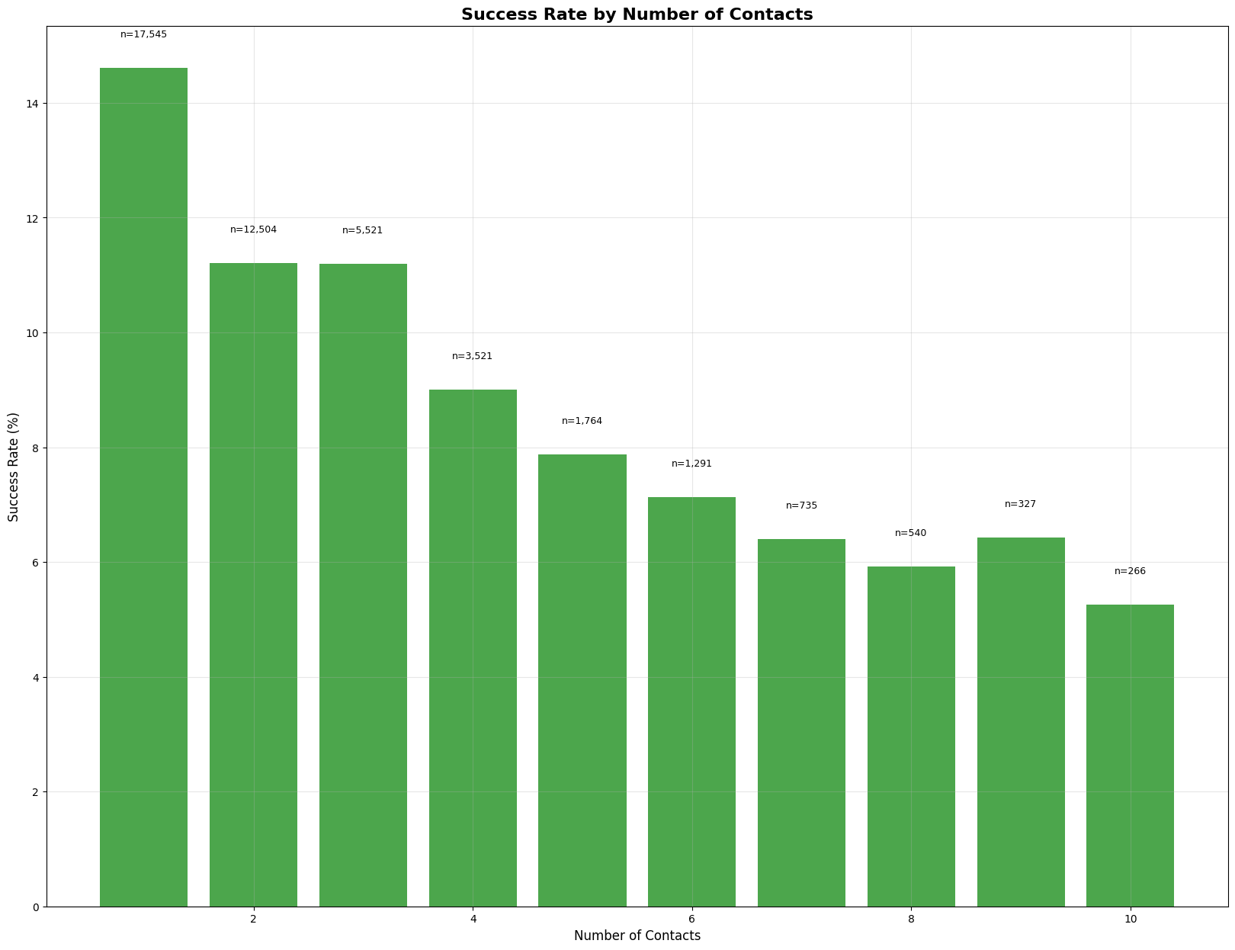
Success Rate Decreases with More Contacts.
The highest success rate (over 15%) occurs when clients are contacted only once. As the number of contacts increases, the success rate steadily declines, dropping to below 6% for those contacted ten times.
This suggests that repeated outreach is less effective and may even diminish the likelihood of a successful outcome.
Majority of Successes Occur with Fewer Contacts.
The sample sizes (n) above each bar show that most clients are reached successfully within the first few contacts. The largest group (n=17,545) is contacted once, with both the success rate and the number of clients sharply decreasing as the number of contacts rises.
This indicates that initial contact attempts are the most productive, while persistent follow-ups yield diminishing returns.

Slide 19
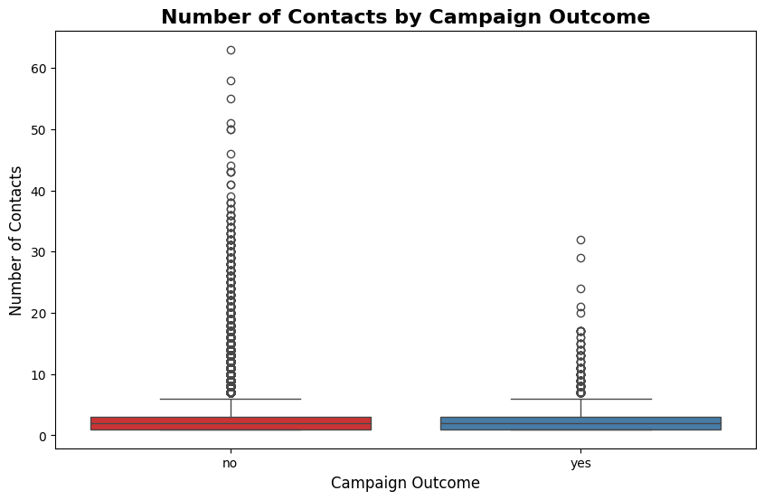
Clients with successful outcomes tend to have fewer contacts.
The median number of contacts is lower for clients with a "yes" (successful) campaign outcome compared to those with a "no" outcome. This suggests that successful conversions are more likely after fewer contact attempts, indicating that persistence beyond a certain point may not increase success.
Unsuccessful outcomes show more extreme outliers.
The "no" outcome group has a much wider spread and more extreme outliers, with some clients being contacted over 60 times. This highlights that repeated follow-up is often associated with unsuccessful outcomes, and excessive contact attempts rarely lead to campaign success.

Slide 20
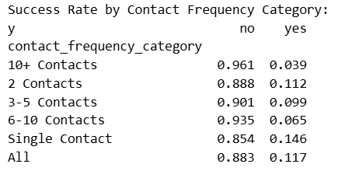
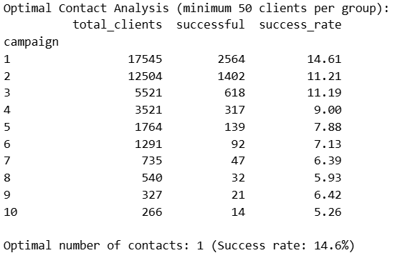
Single contact yields the highest success rate.
Clients who were contacted only once have the highest success rate, with 14.6% of them responding positively. This suggests that the first contact is the most effective, and additional follow-ups tend to yield diminishing returns.
Success rate drops sharply with more contacts.
As the number of contact attempts increases, the success rate declines significantly. For example, clients contacted 10 or more times have a success rate of just 3.9%. This indicates that repeated outreach is less effective and may even reduce the likelihood of a successful outcome.

Slide 21
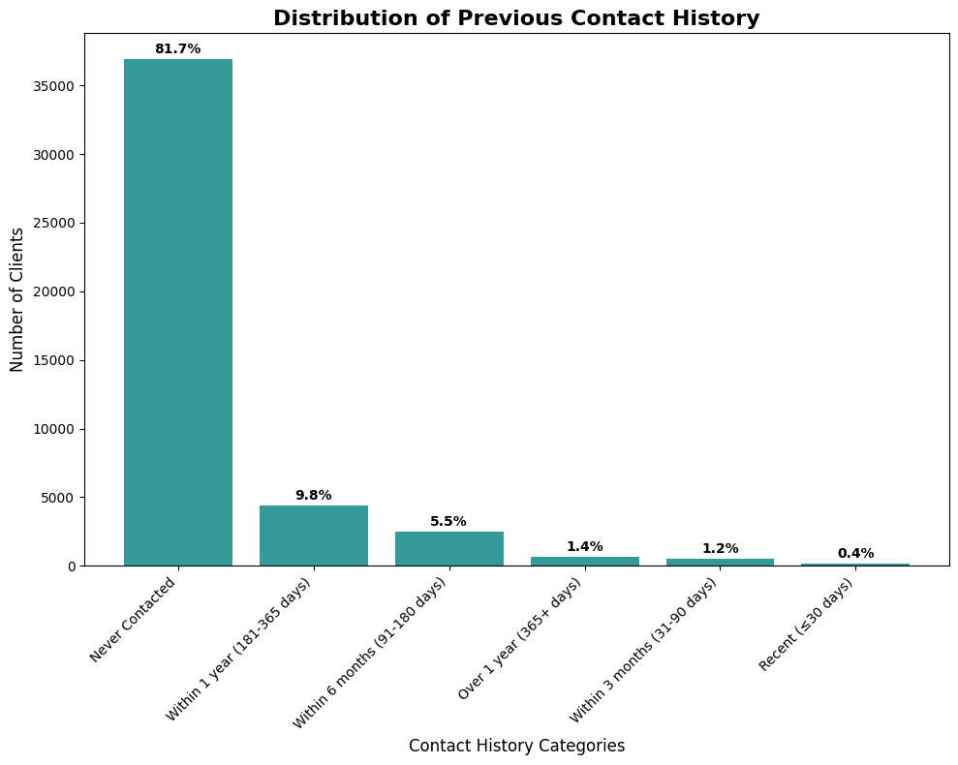
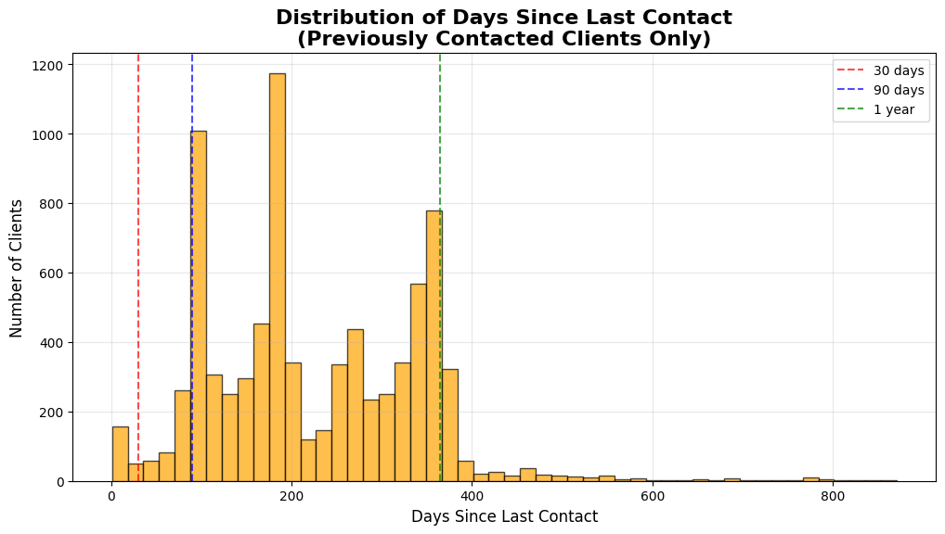
Last contact history from the previous campaign
Most Clients have never been contacted.
A striking 81.7% of clients fall into the "Never Contacted" category, indicating that the vast majority have not received any prior outreach. This highlights a significant untapped segment within the client base.
Recent or Frequent Contact is rare.
Only a small fraction of clients have been contacted recently: just 0.4% were reached within the last 30 days, and only 1.2% within the last 3 months. This suggests that follow-up and ongoing engagement are limited, with most previously contacted clients not receiving regular communication.

Slide 22
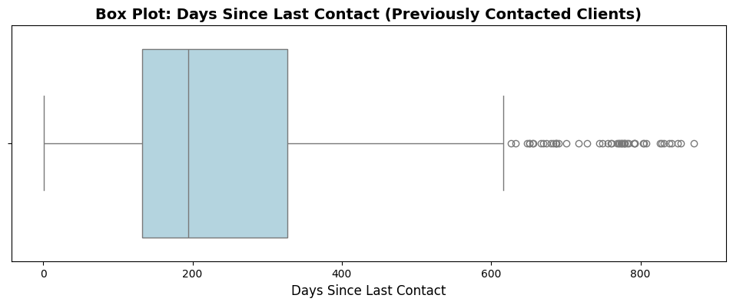
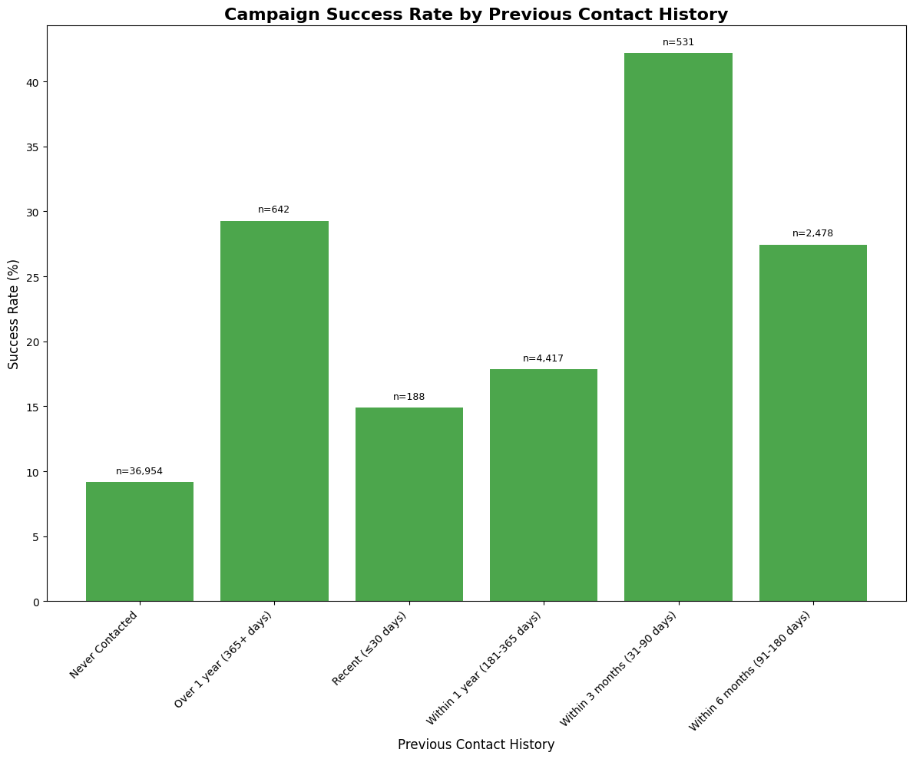
Clients contacted within the last 3 months have the highest success rate.
The campaign success rate peaks at over 40% for clients who were contacted within the last 3 months (31–90 days). This suggests that recent engagement is a strong predictor of positive campaign outcomes.
Most clients have never been contacted, and their success rate is low.
The majority of clients fall into the "Never Contacted" category, with a much lower success rate (around 10%) compared to those with recent contact. This highlights a large untapped segment where outreach efforts have been minimal and less effective.

Slide 23
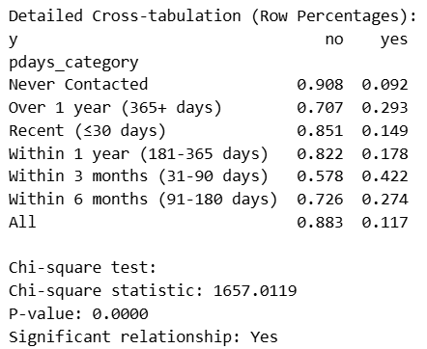
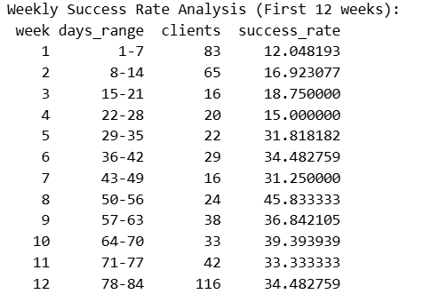
Success rate increases with recent contact.
Clients who were contacted within the last 3 months (31–90 days) have the highest campaign success rate, exceeding 40%. This demonstrates that recent engagement is a strong predictor of positive outcomes, while those never contacted have a much lower success rate (around 9%).
Statistically significant relationship between contact recency and success.
The chi-square test reveals a highly significant relationship (p-value = 0.0000) between the recency of contact and campaign success. This confirms that how recently a client was contacted is strongly associated with the likelihood of a successful campaign outcome.

Slide 24
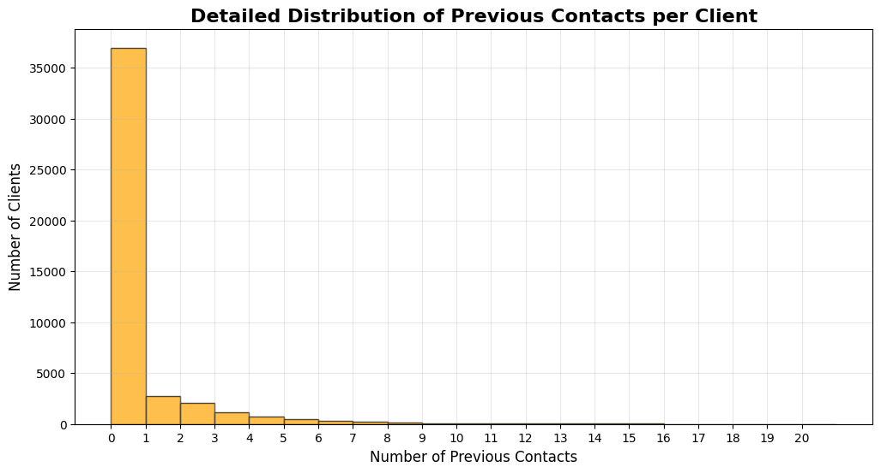
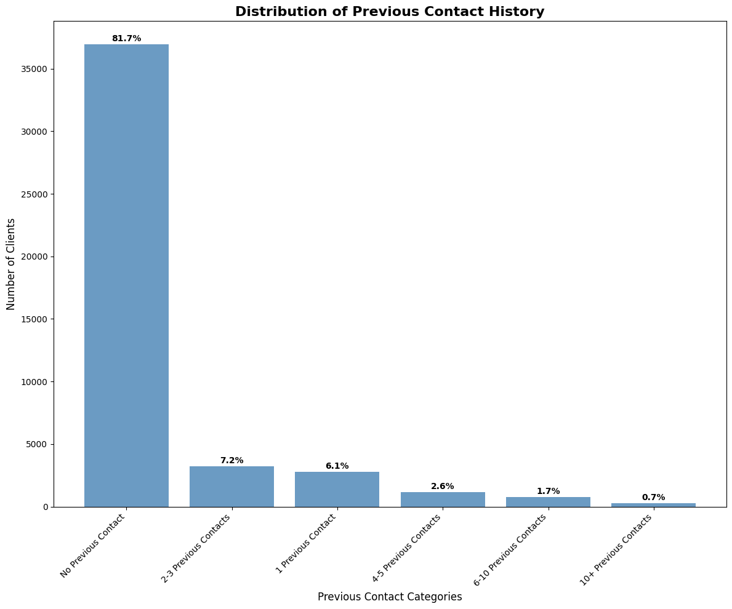
Contacts performed before current campaign
Most Clients have never been previously contacted.
An overwhelming majority—81.7% of clients—have had no previous contact. This highlights that most of the client base represents a fresh audience for outreach efforts.
Multiple previous contacts are rare.
Only a small fraction of clients have been contacted more than once: 7.2% had 2–3 previous contacts, and even fewer fall into higher contact categories. This indicates that repeated outreach is uncommon, and most clients are not frequently re-engaged.

Slide 25
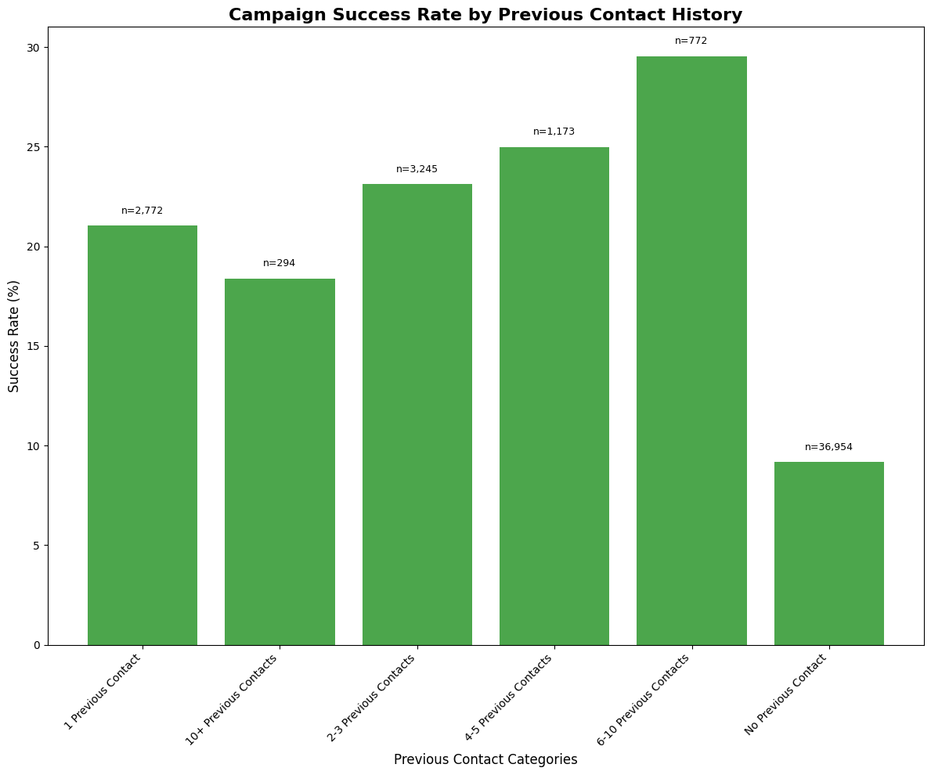
Clients with 6–10 previous contacts have the highest campaign success rate, approaching 30%. This suggests that, although most clients have never been contacted before, those with a moderate history of prior engagement are much more likely to respond positively to campaign efforts.

Slide 26
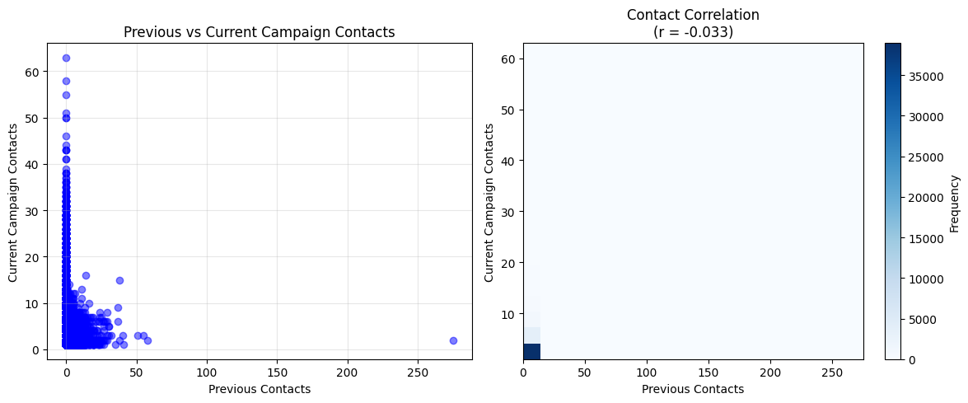
No meaningful Correlation between Previous and Current contacts.
The correlation coefficient between previous and current campaign contacts is extremely low (r = -0.033), indicating virtually no linear relationship. This suggests that the number of times a client was contacted in previous campaigns does not predict how many times they are contacted in the current campaign.
Most Clients have few Contacts in both campaigns.
The majority of data points are densely clustered near the origin, with most clients having fewer than 10 contacts in both previous and current campaigns. High numbers of contacts are rare, and outliers with many contacts are exceptional cases. This demonstrates that repeated or intensive outreach is uncommon for most clients.

Slide 27
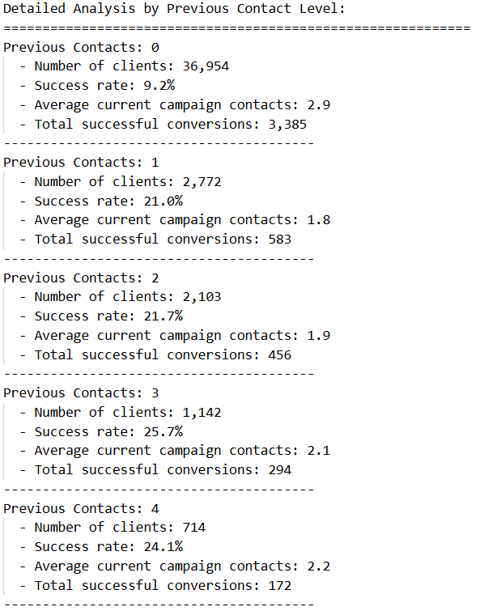
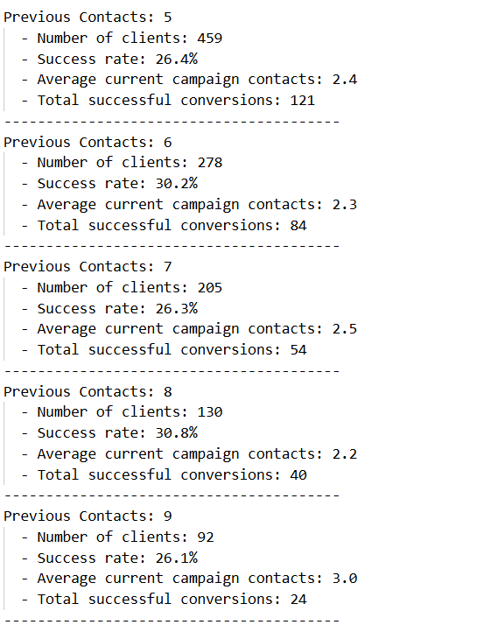
Clients with more Previous contacts have higher success rates
The success rate increases notably as the number of previous contacts rises. For example, clients with 0 previous contacts have a success rate of only 9.2%, while those with 6–8 previous contacts see success rates exceeding 30%. This suggests that repeated prior engagement significantly boosts the likelihood of a successful campaign outcome.
The vast majority of clients have never been Previously contacted
Most clients (36,954 out of the total) fall into the "0 previous contacts" category, representing over 80% of the client base. This highlights a substantial untapped segment, but also shows that the highest volume of successful conversions comes from this group simply due to its size, despite the lower individual success rate.

Slide 28
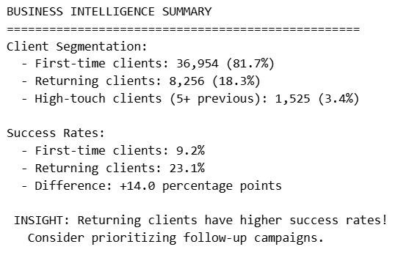
Returning Clients have much higher success rates.
Returning clients achieve a success rate of 23.1%, which is significantly higher than the 9.2% success rate for first-time clients. The difference of 14 percentage points highlights the value of follow-up and re-engagement efforts.
First-time Clients dominate the client base.
The vast majority of clients (81.7%) are first-time clients, while only 18.3% are returning and just 3.4% are high-touch clients (with 5 or more previous interactions). This suggests a large untapped opportunity to improve overall success by focusing on converting more first-time clients into returning ones.

Slide 29


Outcomes of previous Marketing Campaign
The Vast majority of clients have unknown outcomes.
A striking 81.7% of clients fall into the "unknown" category for previous campaign outcomes. This indicates that for most clients, there is no recorded information on the result of earlier marketing efforts, highlighting a significant gap in campaign tracking or data collection.
Successes are rare compared to failures.
Only 3.3% of clients had a "success" outcome in previous campaigns, while 10.8% experienced "failure." This shows that successful campaign conversions are relatively uncommon, and unsuccessful attempts are more than three times as frequent as successes.

Slide 30

Clients with Previous success have exceptionally high success rates.
Clients whose previous campaign outcome was a "success" achieve a current campaign success rate of 64.8%. This is dramatically higher than the overall average success rate (11.7%) and indicates that prior positive engagement is a strong predictor of future campaign success.
Most Clients have unknown or unsuccessful Previous outcomes, with much lower success rates.
The majority of clients fall into the "unknown" or "failure" categories for previous campaign outcomes, with success rates of only 9.2% and 12.6%, respectively. These rates are below or just above the overall average, highlighting that lack of prior success or missing data is associated with much lower chances of current campaign success.

Slide 31


Previous Campaign success strongly predicts future success.
Clients with a "success" outcome in the previous campaign have an exceptionally high current campaign success rate of 64.8%. This is far above the overall average and other outcome groups, showing that prior positive engagement is a powerful predictor of future campaign conversions.
Statistically significant relationship between Previous and Current outcomes.
The chi-square test confirms a highly significant relationship between previous campaign outcome and current campaign success (p-value = 0.000000). This means that knowing a client's past campaign result provides valuable insight into their likelihood of converting in the current campaign.

Slide 32

Clients with Previous Campaign success have the highest Current success rate.
Among clients whose previous campaign outcome was "success," a majority (980 out of 1,513, or about 64.8%) also achieved a "yes" result in the current campaign. This indicates that prior campaign success is a strong predictor of future positive outcomes.
Most Clients have unknown previous outcomes and lower success rates.
The largest group by far falls into the "unknown" previous outcome category (over 36,000 clients). Their current campaign success rate is much lower (3,387 out of 36,959, or about 9.2%), highlighting both a data gap and a substantially lower likelihood of conversion among clients with no recorded campaign history.

Slide 33



Slide 34

Clients contacted only once have the highest success rate (14.6%), and the success rate drops sharply as the number of contact attempts increases. This indicates that initial outreach is the most effective, while repeated follow-ups yield diminishing returns.

Slide 35

Clients with Previous campaign success have exceptionally high conversion rates.
Clients whose previous campaign outcome was a "success" achieve a current campaign success rate of 64.8%, which is dramatically higher than the overall average. This highlights the strong predictive power of past positive engagement for future campaign success.
Most Clients have unknown Previous outcomes and much lower success rates.
The majority of clients fall into the "unknown" previous outcome category, with a current campaign success rate of only 9.2%. This indicates both a significant data gap and a substantially lower likelihood of conversion among clients with no recorded campaign history.

Slide 36


Distribution of Clients who subscribed to a Term Deposit vs. those who did not
The vast majority of clients did not subscribe to the term deposit, with only about 12% choosing to subscribe while nearly 88% declined. This highlights a significant challenge in converting clients to term deposit products, as most remain uninterested despite outreach efforts.

Slide 37

Students and Retired Clients have the highest subscription rates.
Among all job categories, students and retired individuals show the highest subscription rates, with students leading significantly. This suggests that these groups are more receptive to subscribing to the term deposit product compared to other professions.
Higher Education and Recent Contact methods boost success.
Clients with tertiary education and those contacted via cellular phones exhibit the highest subscription rates within their respective categories. This highlights the positive impact of higher educational attainment and modern communication methods on campaign effectiveness.

Slide 38


High Return on Investment despite low success rate.
The campaign achieved a success rate of only 11.71%, yet the estimated return on investment (ROI) is exceptionally high at 747.2%. This indicates that even a relatively small proportion of successful subscriptions can generate substantial net profit when the campaign is efficiently managed and the product has strong revenue potential.
Results are Statistically Robust due to large sample size.
With a sample size of 45,210 clients contacted and a narrow 95% confidence interval for the subscription rate ([11.41%, 12.00%]), the findings are highly reliable. The low standard error (0.151%) further confirms that the results are statistically robust and not due to random chance.

Slide 39

Correlations between different attributes and the likelihood of Subscribing to a Term deposit

Slide 40

Contact duration has the Strongest Positive Correlation with Subscription.
The variable "duration" (length of last contact) shows the highest positive correlation (0.394) with term deposit subscription. This means that longer conversations with clients are strongly associated with a higher likelihood of subscribing.
Recency and Frequency of Previous Contacts also matter.
"pdays" (days since last contact) and "previous" (number of contacts performed before this campaign) have moderate and weak positive correlations (0.104 and 0.094, respectively) with subscription. This suggests that clients who were contacted more recently or have had more previous contacts are slightly more likely to subscribe.

Slide 41
Thank you

